Slide 1
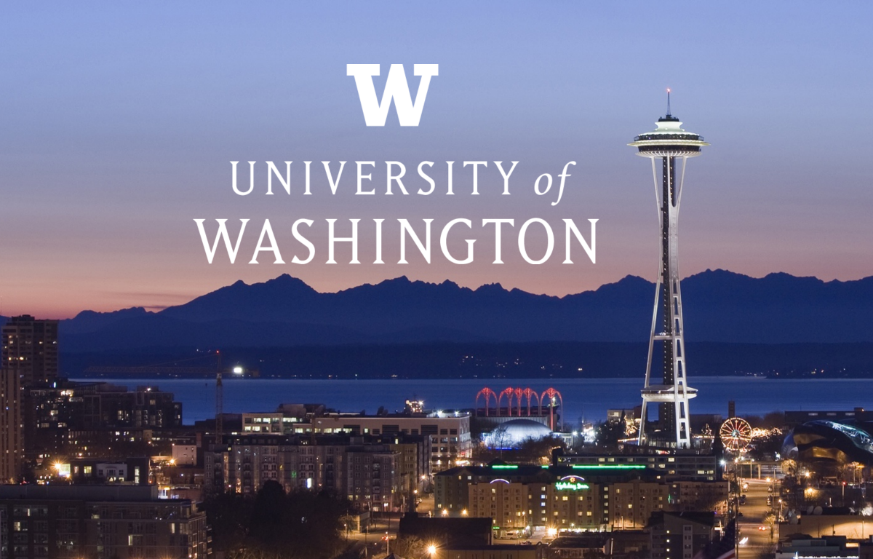
Runstad Department of Real Estate - Master of Science in Real Estate

Slide 2
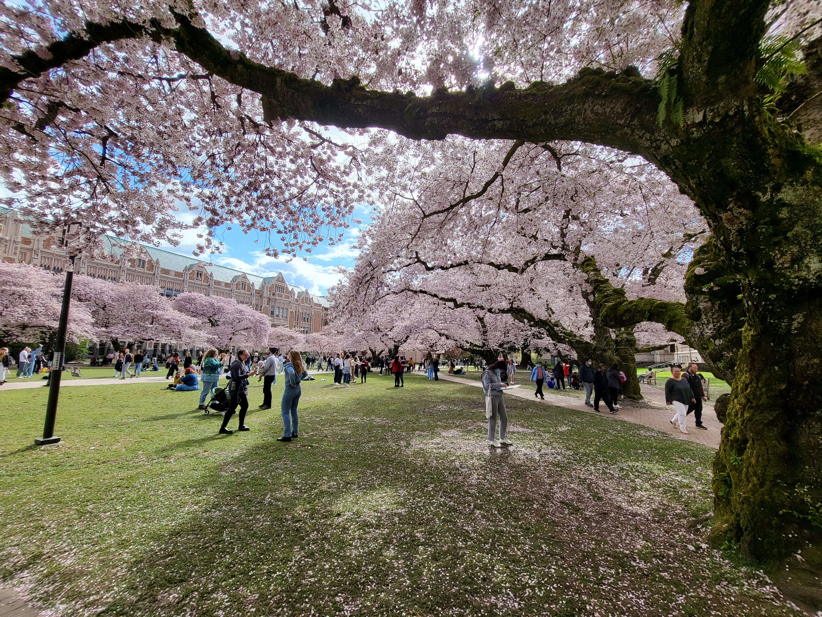
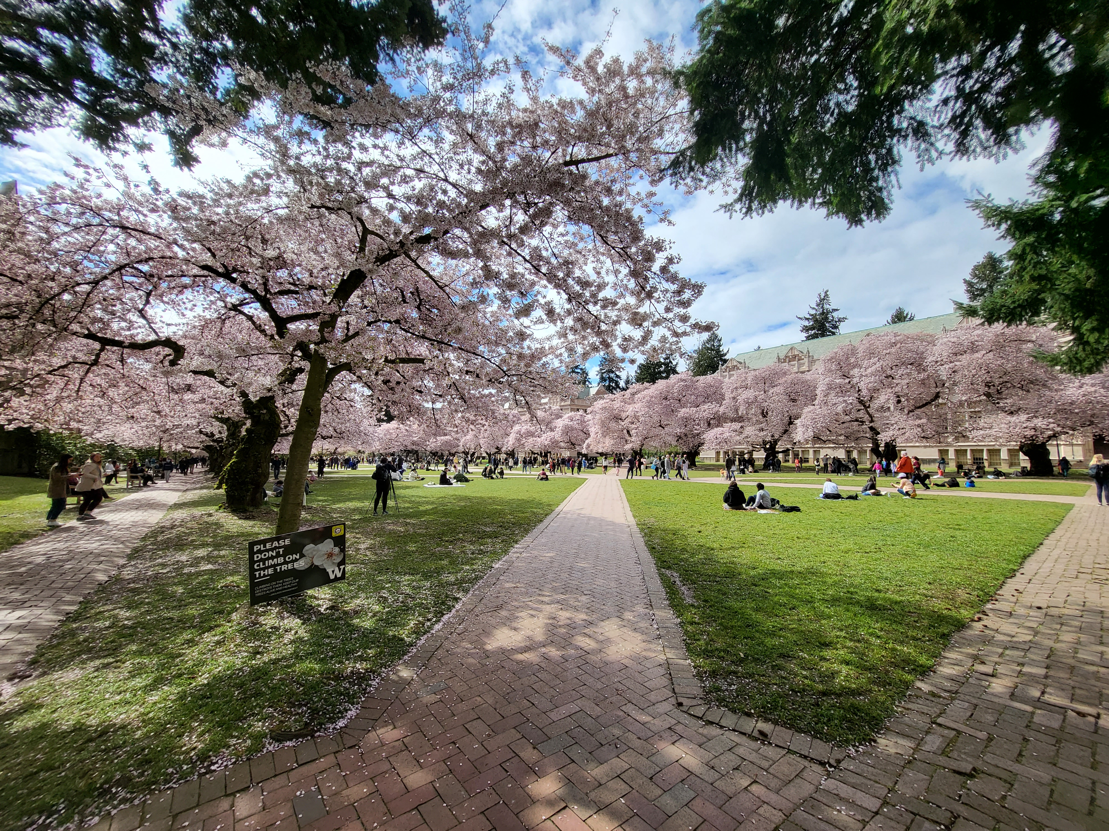
Welcome to our virtual Open House

Slide 3
Today’s schedule
Time (PT) | Agenda Item | Participants
10:00-11:00am | MSRE program welcome and overview | Dept. Chair/Dir. Grad Programs Dermisi, Assistant to Chair Best, Acad. Advisor Anderson
11:15am-12:15pm | Meet the faculty | Asst. Prof. Acolin, Prof. Dermisi, Asst. Prof. Colburn, Mr. McCann, Mr. Shannon Affholter, Mrs. Vishwakarma
12:15pm-12:45pm | LUNCH BREAK
12:45-1:30pm | Meet the Real Estate Club and Students | Mr. Liebreich, Mr. Cameron, Ms. Paulsen, Ms. Chim, Mr. Stamolis, Ms. Hua
1:45-2:45 pm | Meet the Advisory Board | Mr. Campbell, Mrs. Sugimura, Mrs. Ford
3:00-4:00pm | The Greater Whole: Rejecting False Binaries | Dean Renee Cheng
Visit Real Estate Open house: https://re.be.uw.edu/2022-msre-virtual-open-house-udent-day/
password: MSRE2022

Slide 4
Overall structure of MSRE (Regular and Advanced standing)
 | Regular standing | Advanced standing
Admission qualifications* | Non-quantitative degree | Quantitative bachelor’s degree
Total credits | 70 | 41
Length – Full-time | 2 years (6 quarters) | 1 year (3 quarters)
Length – Part-time | Advisor/student coordination | 2 years (6 quarters)
Courses (credits) | Link | Link
Business skills Technical & Software skills Real Estate Core Capstone Electives | 15 14 27 4 10 | 6 4 17 4 10
* All transcripts are reviewed for inclusion of quantitative courses [e.g. statistics, accounting/financial reporting, management, and visualization techniques(e.g. econometrics, programing, coding etc.)]

Slide 5
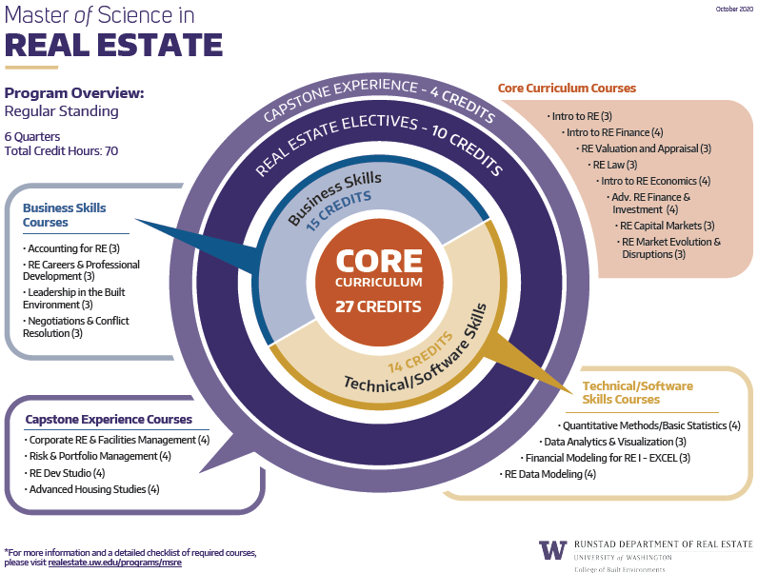
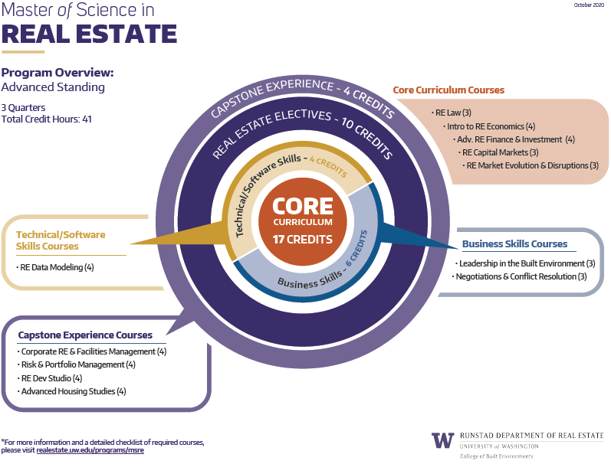
Master of Science in Real Estate/UW – Regular & Advance standing

Slide 6
Master of Science in Real Estate - UW
Typical course sequencing Regular & Advanced MSRE standing
  Regular standing Advanced standing
  Full-time (6 quarters) Full-time (3 quarters)

Slide 7
What are the Real Estate Career Options?
ADVISORY
DEVELOPMENT
BANKING & FINANCE
INVESTMENT MANAGEMENT
CORPORATE REAL ESTATE
PUBLIC POLICY
BROKERAGE
DEVELOPMENT COMPANIES
COMMERCIAL BANKS
INSTITUTIONAL INVESTORS
CORPORATIONS
COMMUNITY AND ECONOMIC DEVELOPMENT
REAL ESTATE SERVICE FIRMS
HOMEBUILDERS
INVESTMENT BANKS
REITS
ADVISORY FIRMS
HOUSING AUTHORITIES AND NONPROFIT DEVELOPERS
INVESTMENT ADVISORY
CAPITAL MARKETS
FUND MANAGERS
STATE HOUSING FINANCE AGENCY
RESEARCH
CREDIT RATING AGENCIES
ASSET MANAGEMENT
ACCOUNTING FIRMS

Slide 8
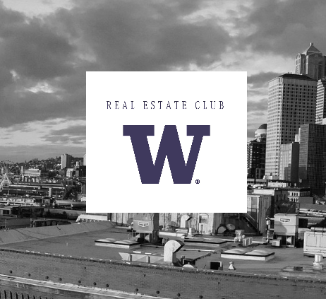
Real Estate Club
Opportunity to connect with real estate professionals
See complex and interesting development projects during and after construction
Share your passion for real estate with fellow students
Attend Lunch and Learns to meet with real estate professionals
Events: http://www.uwreclub.com
Contact: UWREClub@gmail.com

Slide 9
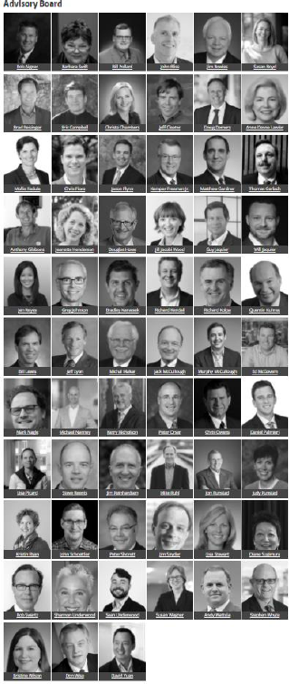
Real Estate Community
Mentors
Alumni
Advisory Board
More info: http://realestate.washington.edu/re-people/community/
Contact: msre@uw.edu
Alumni contact: uwrealestatealumni@gmail.com

Slide 10
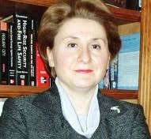
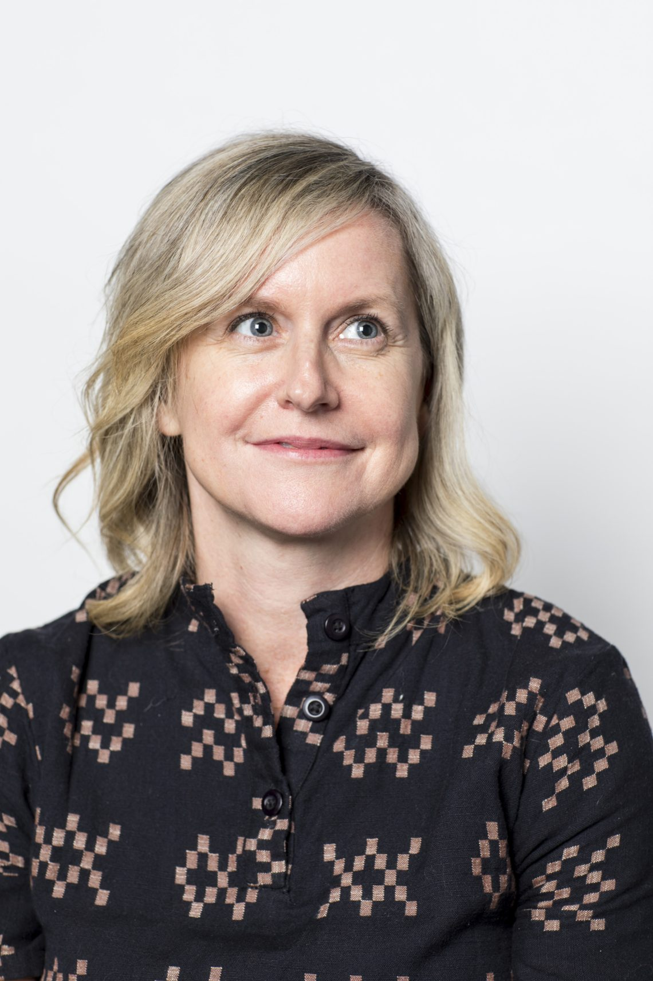
Master of Science in Real Estate/UW – Program Contacts
Program Contacts
Dr. Sofia Dermisi Lyon and Wolff Endowed Professor in Real Estate Program Director, Graduate Programs Email: sdermisi@uw.edu | Melissa Best Academic Advisor Email: msre@uw.edu
General information:
http://www.seattle.gov/
MSc Real Estate:
https://re.be.uw.edu/
International Student Service UW
http://iss.washington.edu

Slide 11
MSRE orientation August (virtual), September (in-person)
 | Agenda
Late August - Day 1 (half day - virtual) | Program Welcome Student Introductions MSRE overview (Dermisi, Best, Louie) Part A ● Curriculum and general program requirements ● Advising process & policies Part B ● Break-out room for Advanced and Regular standing
Late August - Day 2 (half day- virtual) | Meet the Faculty Business skills, Technical skills/core, Core/Capstone
September | Individual student advising
Friday 9/23 (tentative) | Program Welcome Student Introductions Real Estate Organizations Panel Things to know as an international student at UW Obtain your UWID/transit pass
Monday - 9/26 (tentative) | Introduction to the Department’s Advisory Board Department & Board Student Experience Committee – workshop EDI Committee – workshop Panel – What are employers looking for The Downtown Seattle Real Estate Market and the Regional Context Informal Board reception
Tuesday - 9/27 (tentative) | Building community panel (between MSRE1 & 2) College of Built Environments Orientation

Slide 12
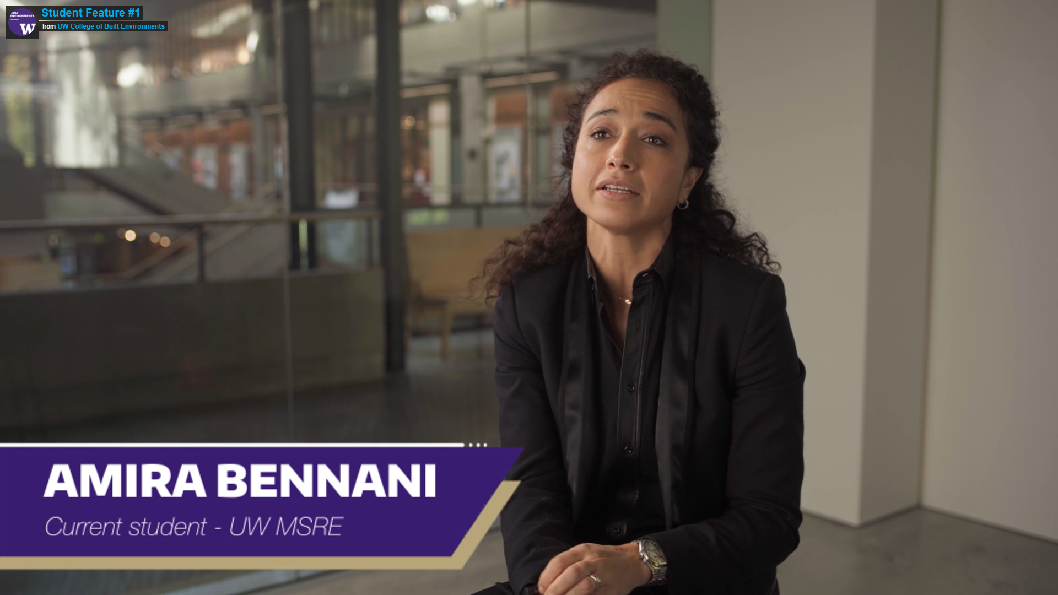
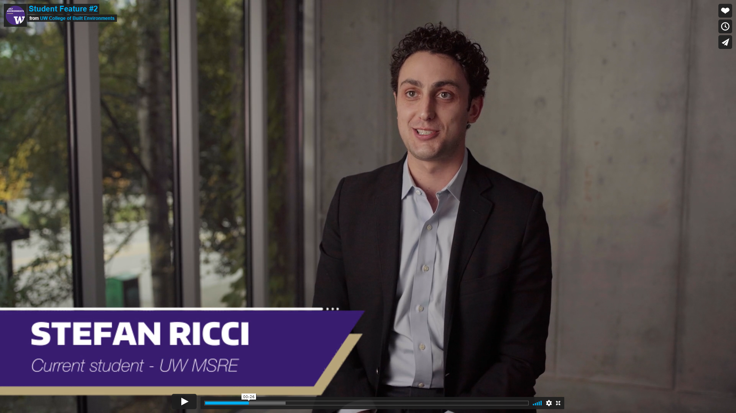
Student Vignettes
Visit Real Estate Open house: https://re.be.uw.edu/2022-msre-virtual-open-house-udent-day/
password: MSRE2022

Slide 13
Master of Science in Real Estate - UW
Why consider the MSRE at UW?
  Students with quantitative backgrounds can fast-track the completion of the degree in 3-quarters
  Students can specialize in Corporate Real Estate, which is unique among real estate degrees
  All MSRE students regardless of standing (regular or advanced) can transfer a max of 6 credits not used for their undergraduate degree towards the MSRE
  The UW/MSRE is designated as a STEM degree, which is rare across RE programs (international students - eligible for max 3 years post-graduation U.S. work)
  The Runstad Department of Real Estate benefits from a very active Advisory Board of leading area professionals and alumni network willing to engage with students and help them in their future endeavors
  Seattle is home of 11 fortune 500 companies among others, in need of real estate expertise
  Due to the lack of diversity in the industry there is a significant push to attract more diverse professionals within real estate organizations leading them to offer scholarships and outreach (e.g. NAIOP, IREM, BOMA etc.)

Slide 14


Thank you
Questions??
Master of Science in Real Estate

